Slide 1


Prepared for Mojaloop PI-22 Community Event

Slide 2

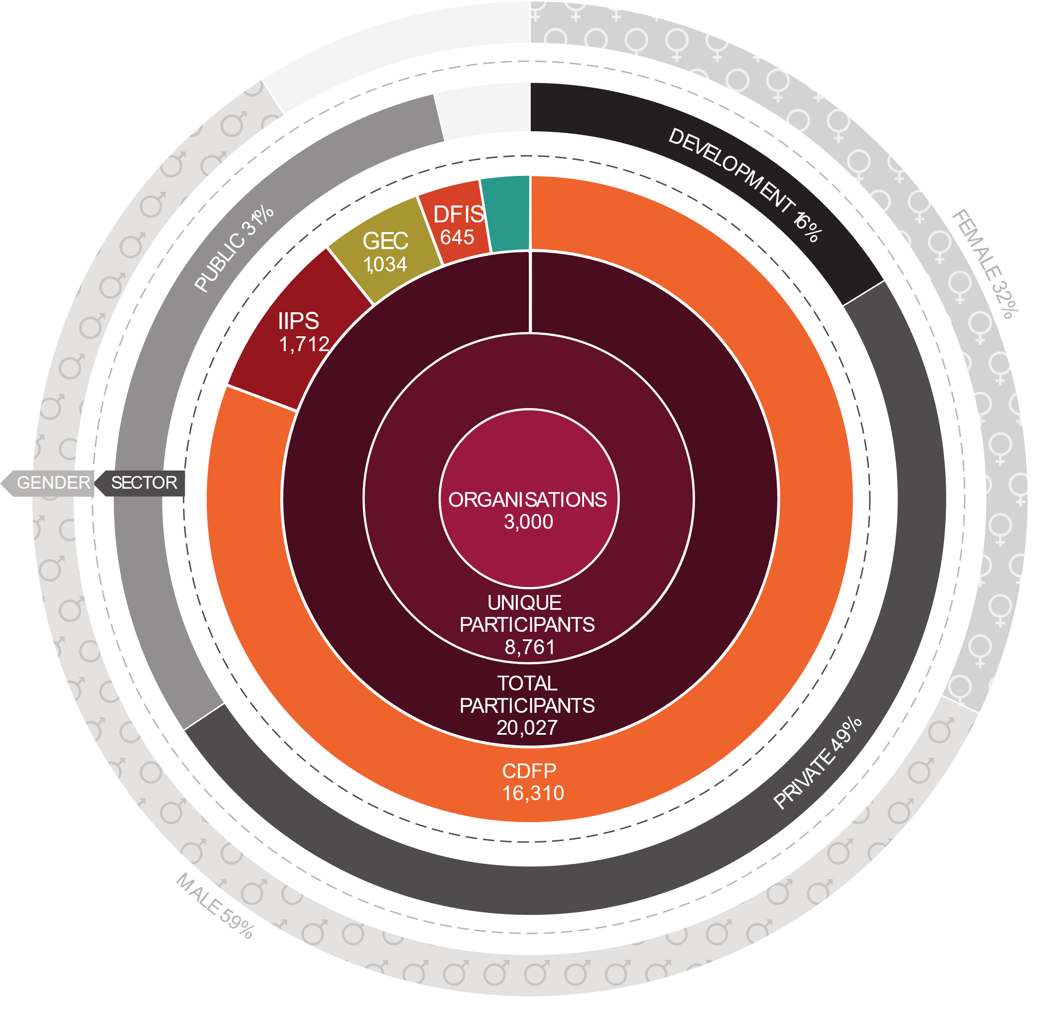
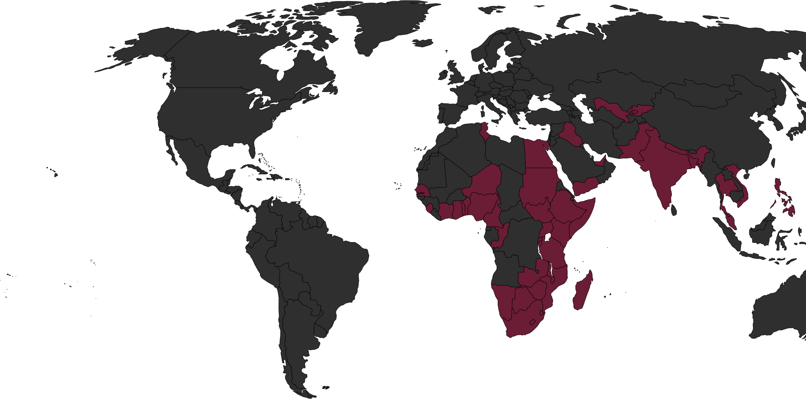
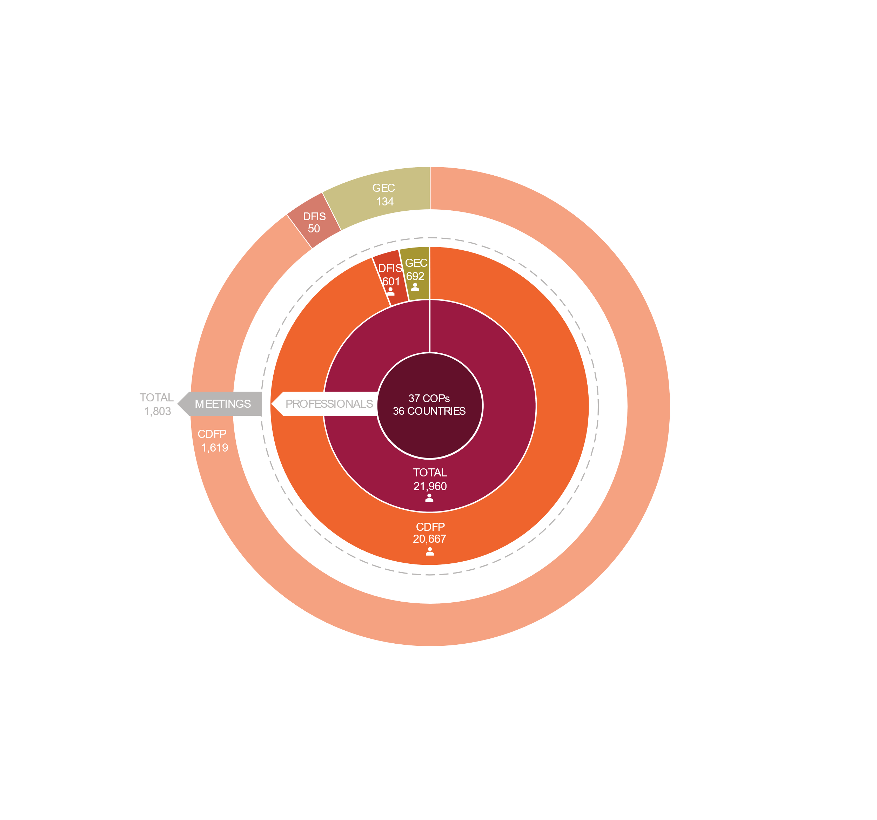
We’ve scaled in the global south, especially in Africa
With a team of 185 over 32 countries, predominantly in Africa, and have proven the ability to scale quickly, execute well, build capacity and convene locally
37
21,960
Communities of Practice
Professionals
36
1,803
3,000
8,761
20,027
170
Countries
Meetings
Organisations
Unique Participants
Total Participants
Countries
Notes:
With a team of 185 over 32 countries, we have convened meetings of 21 000 professional and trained students from over 3000 organisations. By the end of 2022, the Digital Frontiers Institute had already proven significant impact having reached 8761 professionals from 168+ countries and over 3000 organisations, with over 20 027 courses and 830 000 instructional hours delivered with an 86% pass rate. 38 in-person communities of practice across 48 countries convened 20 667 professionals through 1619 meetings and the program dispersed $2.4m in scholarships. The Certified Digital Finance Practitioner programme specifically has reached 7807 professionals, who have participated in 17 371 courses. This represents around 660 438 instructional hours taught.

Slide 3
IIPS
Regulating and governing IIP Systems
Introduction to Instant and Inclusive Payments
Designing and deploying technology for IIP Systems
Inclusive, instant & interoperable: Beyond Finance
Foundations Exam
Final Seminar
Self-paced, you can register anytime
It prepares you to pass the Foundations Exam
50 MCQ
1-hour, online
Ability to apply the 3i concepts more holistically
Bringing everything (and everybody) together
Launching and operating IIP Systems
Provide resources to equip graduates to train others. Facilitator guides
6 weeks, online, synchronous learning
Offered twice a year
www.iipscertification.org
Notes:
1. Assess a markets readiness for IIPS, clearly verbalize the problem it is trying to solve and define the way IIPS will assist in solving the problem by establishing inclusive design principles and business requirements;
2. Be able to set up a program to establish an IIPS scheme with the necessary engagement, resources and activities, aligned to a shared vision among all stakeholders;
3. Motivate for the most appropriate governance, participation and ownership model for the IIPS;
4. Be able to define the requirements for the operational (including technology ownership) and settlement model for the IIPS according to market and supervisory needs;
5. Be able to evaluate the economic impact of the IIPS on the business case of the scheme and its participants;
6. Be able to describe various launch strategies and innovation roadmaps to scale the IIPS successfully.

Slide 4





































































































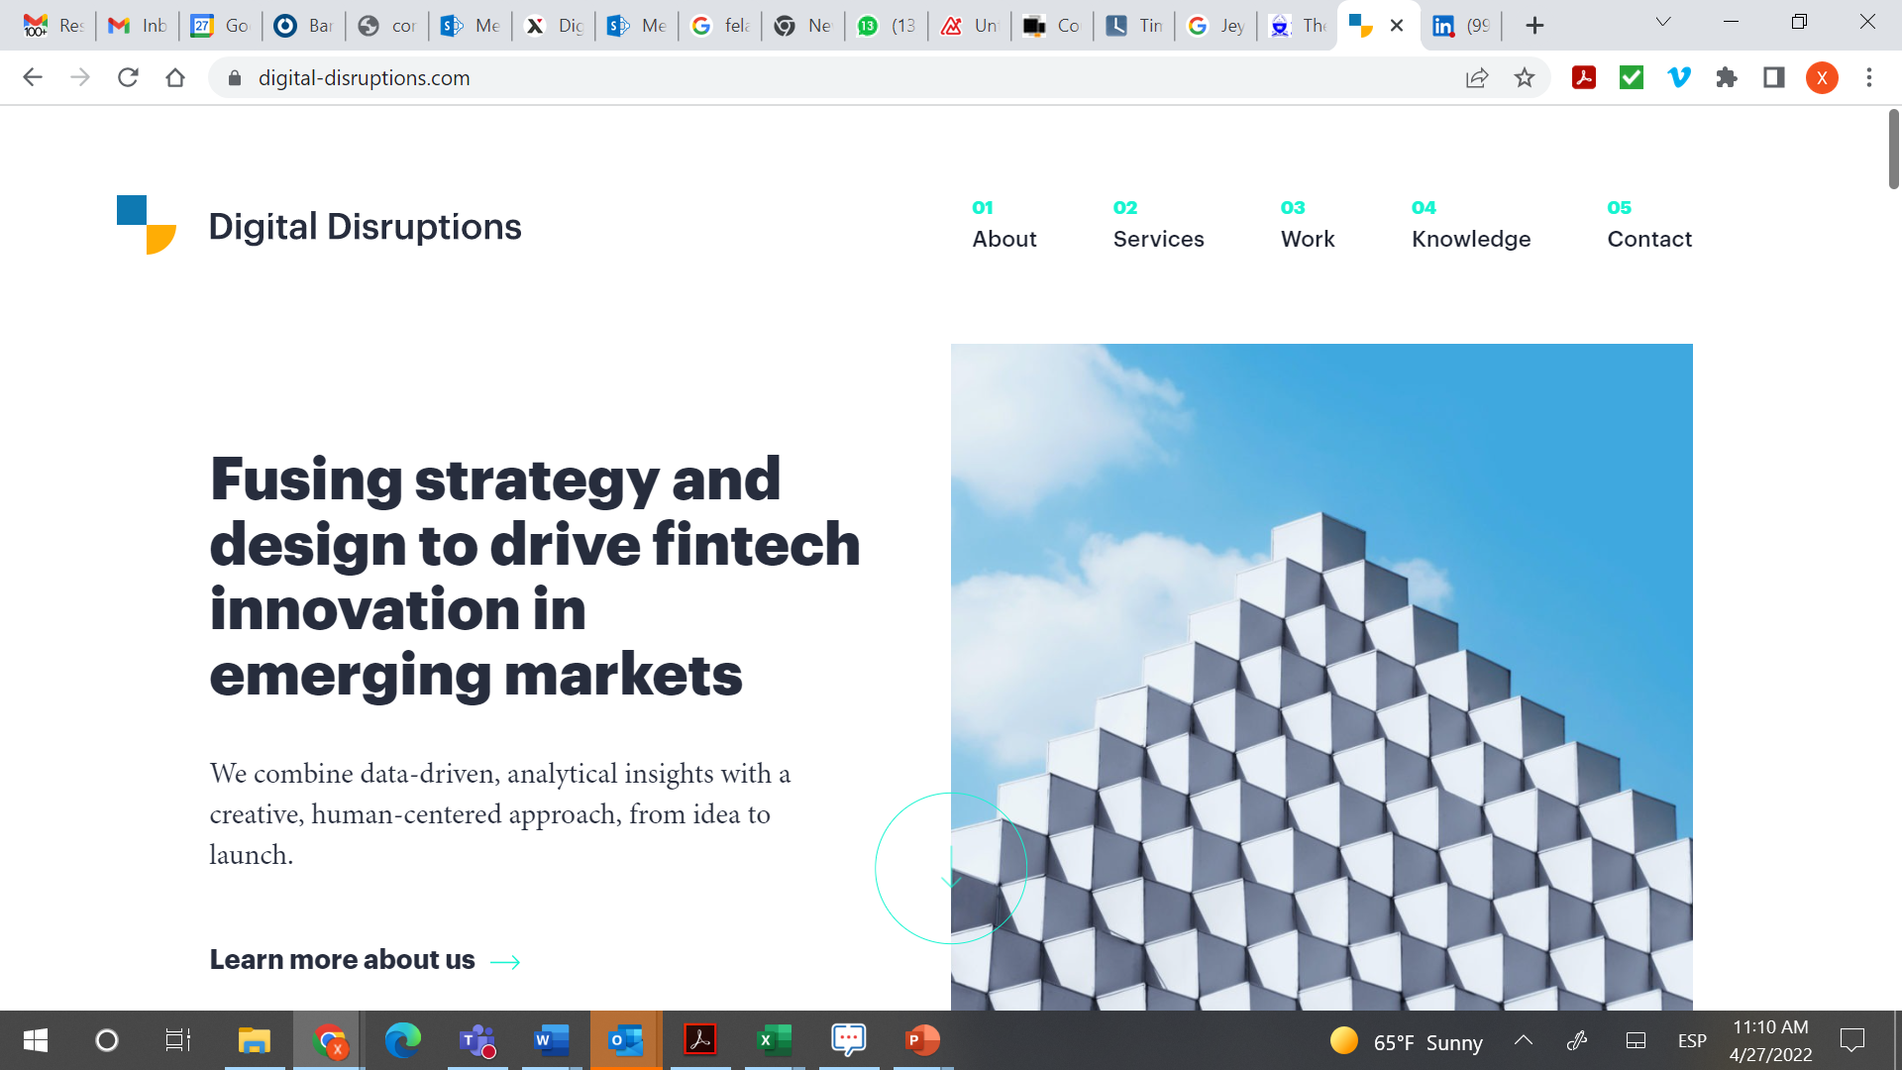





Target Personas
69%
31%
Summary
Instant and Inclusive Payment Systems (IIPS) builds human capital in countries embarking on financial inclusion strategies, especially those building new payment systems. The aim of this program is to build a new league of professionals that have been trained on principles, architectures and implementation guidelines for a country-level digital financial payment system designed to bring the poor into the formal economy. The program strengthens capacity through 3 specialisations:
Bankers
Commercial banks, MFIs, postal banks, credit unions and banking associations
Payment Processors
Gateways, processors, and payment tech providers
Policymakers
Central banks, governments, and international organizations
More than
2000
Unique Enrollments
More than
700
Female
Pro-Poor Policies & Regulation
Regulators and/or the project leads designated to develop the governance/supervision of payment systems who
advocate for a vision for pro-poor DFS, including policy and regulatory harmonization across multiple countries in collaboration with regional and continental bodies.
27%
21%
20%
More than
1000
Certified in Foundations
Consultants
Big management firms, development , and individuals
MNOs & Fintechs
Telcos, emoney issuers, and payment fintechs
National Switches
National payments systems operators
Digital Infrastructure & Technology
More than
800
Specialisations participants
Individuals tasked with the technical design of the payment system and other supporting infrastructure, including leveraging digital public goods (DPGs)
SWITCH
Business Operations & Market Ecosytems
More than
90
Countries represented
Commercial market actors tasked with establishing an IIPS scheme and designing it to achieve inclusive and interoperable objectives.
11%
9%
6%

Slide 5


Achieving Scale, Strengthen Ecosystem
What
How
SKILLS CONSTRAINTS
Bridge the human capital gaps in ability to design, build, operate and oversee IIPS projects, especially in emerging markets.
By reskilling DFSP professionals.
Build-up new knowledge, skills & networks.
We will stimulate an inclusive digital economic development.
Strengthen the enabling environment to commission and oversee design of IIPS.
Strengthen consumer protection regulations
A new league of professionals that have been trained on principles, architectures and implementation guidelines for a country-level digital financial payment system designed to bring the poor into the formal economy
Collaboration & Partnerships
Localised approach
that create in person and online communities
A program that;-
is digital,
has scaled since inception & has the potential of scaling further
Provides unique thought leadership opportunities
Training ecosystem players
Cross border payment systems
Regional approach provides inter-connectedness. Promote knowledge sharing, and capacity building
A Global Alliance that is representative of inclusive finance professionals, 14 country-level Digital Finance Associations
Improved digital public infrastructure skills beyond payments professionals
Re-skilling the broad financial sector with the capabilities to scale Instant & Inclusive Payment Systems across Africa and harmonise policy for an inter-connected continent.

Slide 6



20% of the world's future jobs will be dedicated to solving the world’s
biggest problems.
Skilling and re-skilling for IIPS
Future of payments
Reskilling Crisis
Preparation for growth and innovation
Inclusive Digital Economies
152%
50%
35%
33%
Africa’s e-payments are expected to grow between 2020-2025 by 152%
of all employees will need reskilling by 2030.
Mobile Money IPS in Africa
Africans using internet. Increased connectivity and use of digital technology have started to transform Africa’s job markets, modernise banking, expand financial services to underserved populations
500
40%
Future payments
Growth is likely to be uneven across the continent and will depend on infrastructure readiness, policy and regulation, private and public partnerships
million Africans
of current workers core skills are expected to change in the next 5 years
without proper IDENTIFICATION documents in 2020
35data protection laws in Africa
Source:
McKinsey The Future of Payments ( September 2022) | WEF, Future of Work | SIIPS 2022 (AFRICANENDA) | DATA PROTECTIONN AFRICA | ITU 2021
Where will the workforce for IIPS come from?
What capabilities will they need?
Building blocks for DPI
Future ready economies
Notes:
would they need and are these distinct from main-stream business?

Slide 7
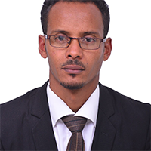
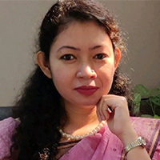
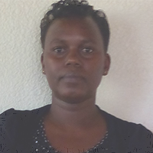
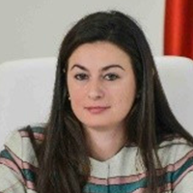
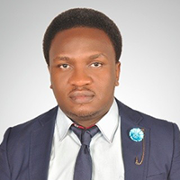
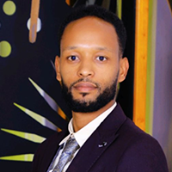
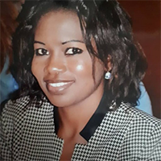
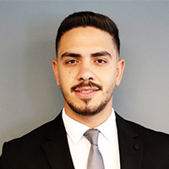
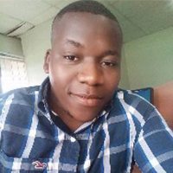
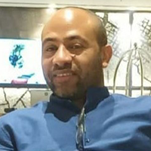
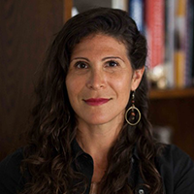
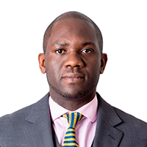
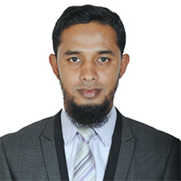
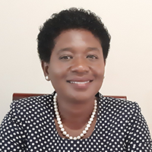
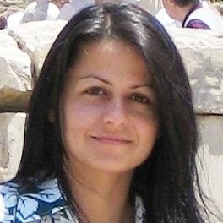
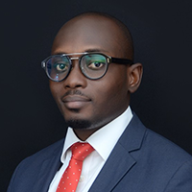
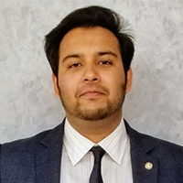
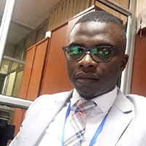
IIPS Bench
Abebaw Belay
Senior Systems Architect EthSwitch S.C.
Israt Jahan
Joint Director
Bangladesh Bank
Adeline Mukashema
Senior Principal Analyst National Bank of Rwanda
Anjeza Beja
Consultant
IMF
Brenden Kachenje
Director of Sales
Bharti Airtel International
Giramu Fekadu
Internal Auditor
EthSwitch S.C.
Haoua Souley
Digital Finance Specialist
Consultant
Hussam Hammad
Project Manager
JoPACC
Innocent Mghogho
Digital Business Specialist FINCA Malawi
Abel Taddele
Program Director
Ethswitch S.C.
Jill Lagos Shemin
Engagement Lead
CCAF
Kombe Kaponda
Financial Markets Specialist Central Bank of Zambia
Abdul Mumin
Assistant Vice President
Union Bank Limited
Mika Chundu
Digital Payment Systems Consultant
Aurela Zoto
Program Manager
SWIFT
Nana Nsiah Danso
Head of eBanking
Fidelity Bank Ghana
Soban Najam
Program Manager
Paysys Labs
Njelesani Kayula
Risk Officer
ZECHL
7

